Slide 1
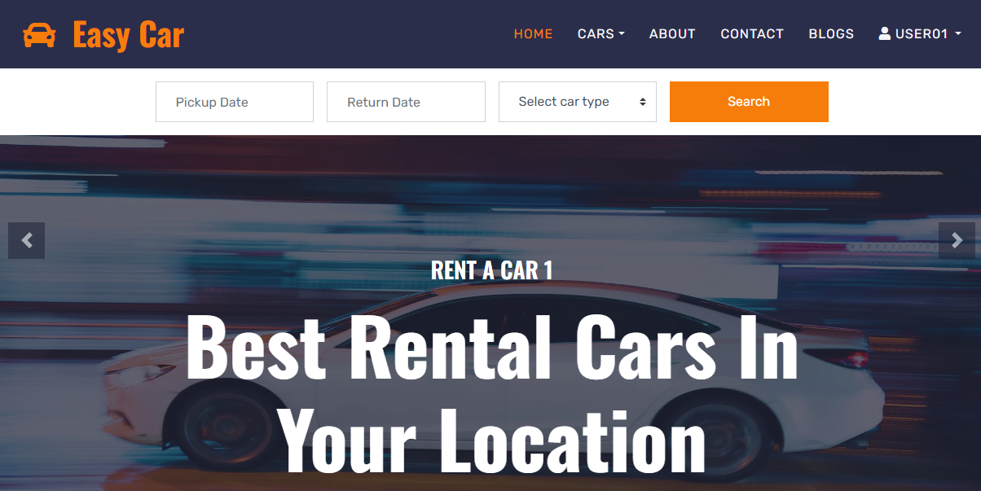
EASY CAR

Slide 2
EASY CAR
Group 1 – T5.2303.E0:
Nguyễn Quốc Thiện - Student1468208
Phan Đặng Hoàng Tiến - Student1468189
Vũ Quốc Việt - Student1468213
Trần Thanh Hải - Student1237676

Slide 3
TRẦN THANH HẢI

Slide 4
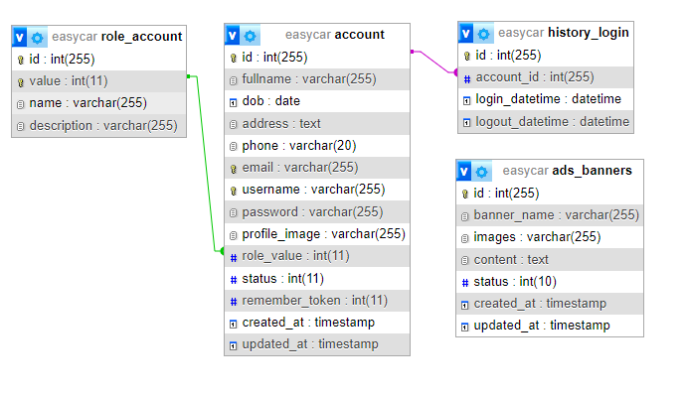
Database

Slide 5
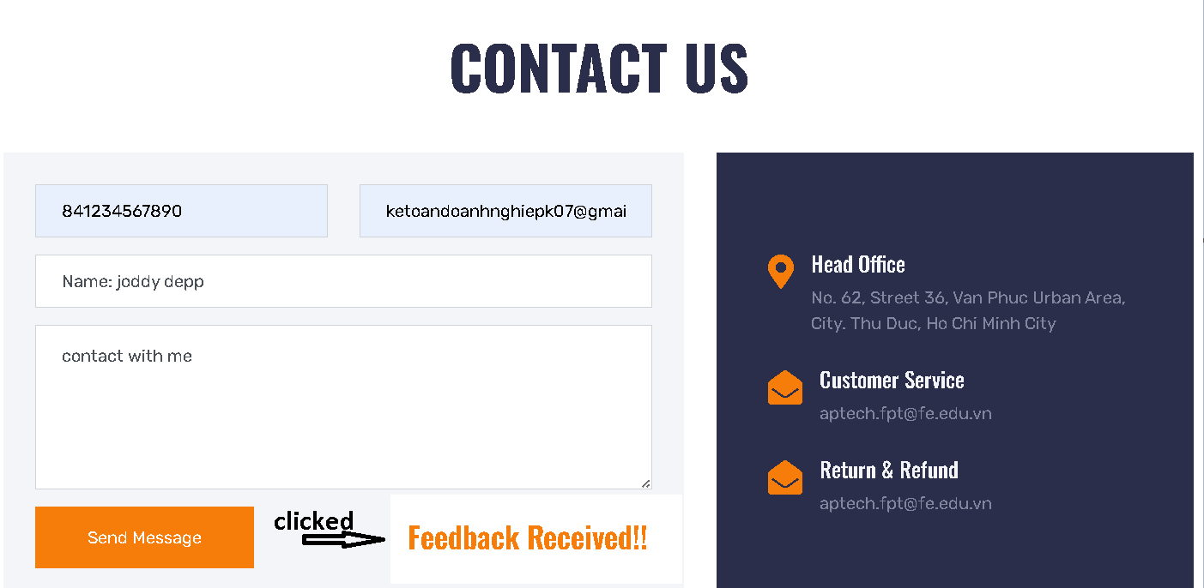
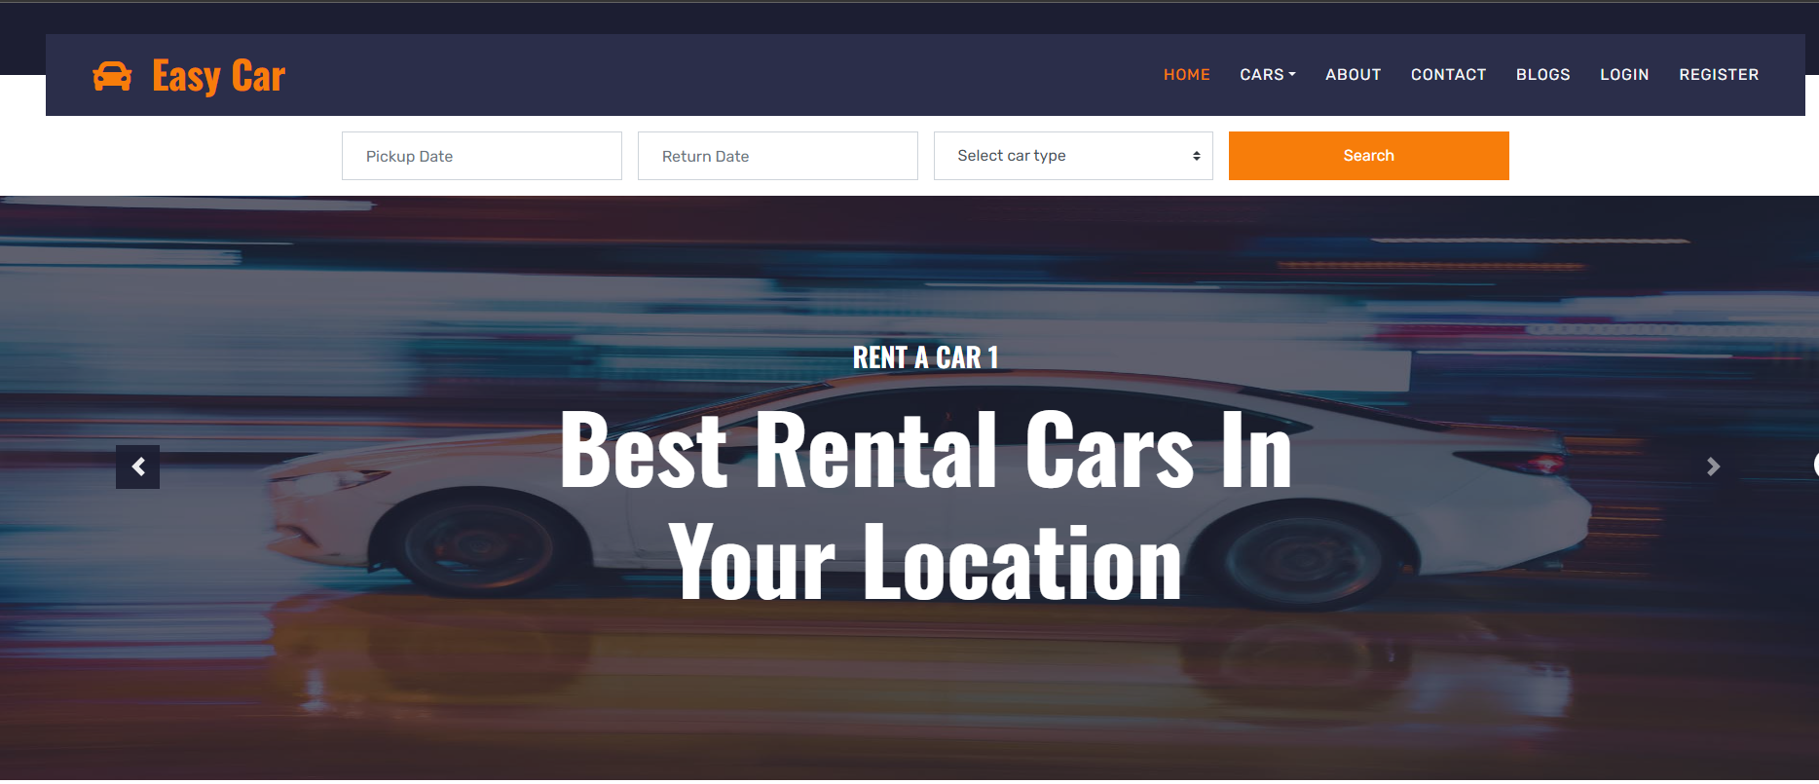
Giao diện List Banner

Slide 6
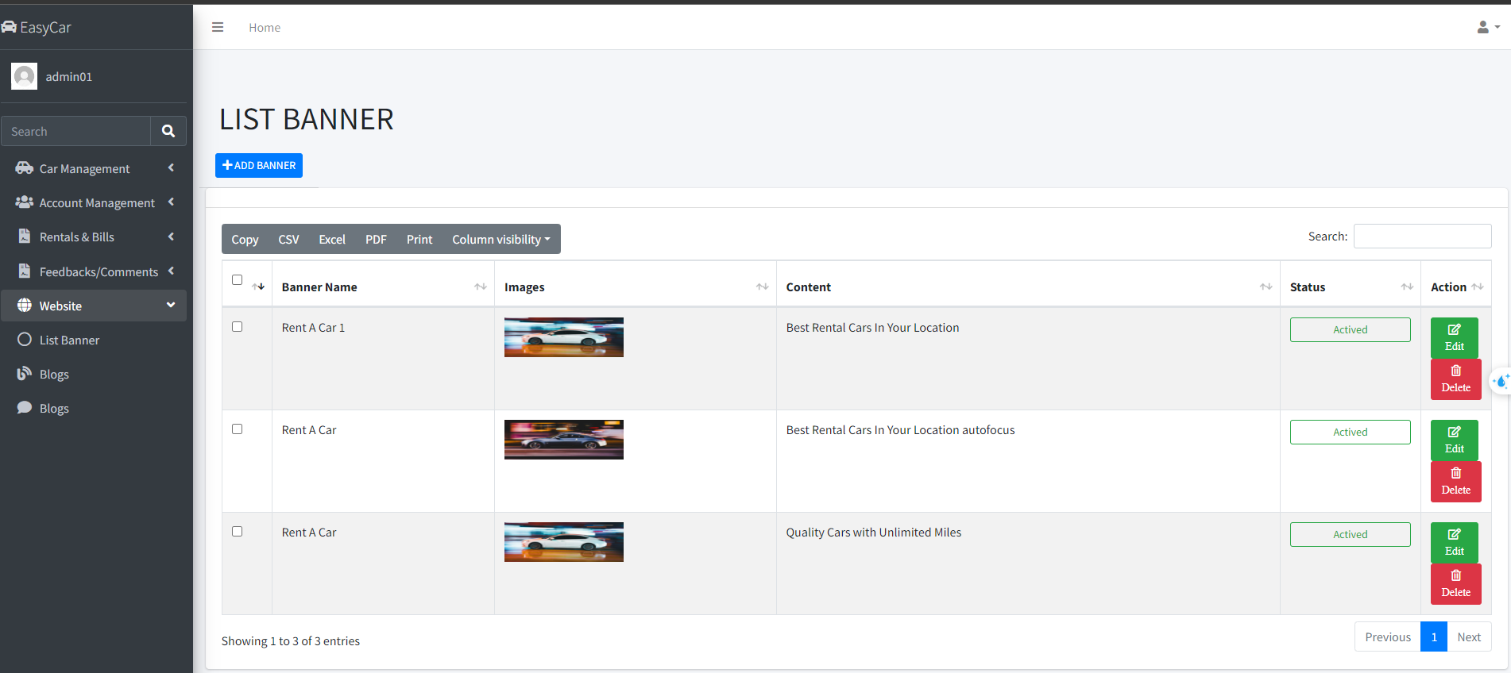
Quản lý List Banner

Slide 7
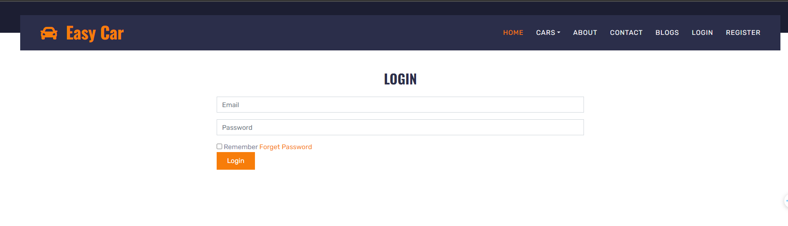
Giao diện Login

Slide 8
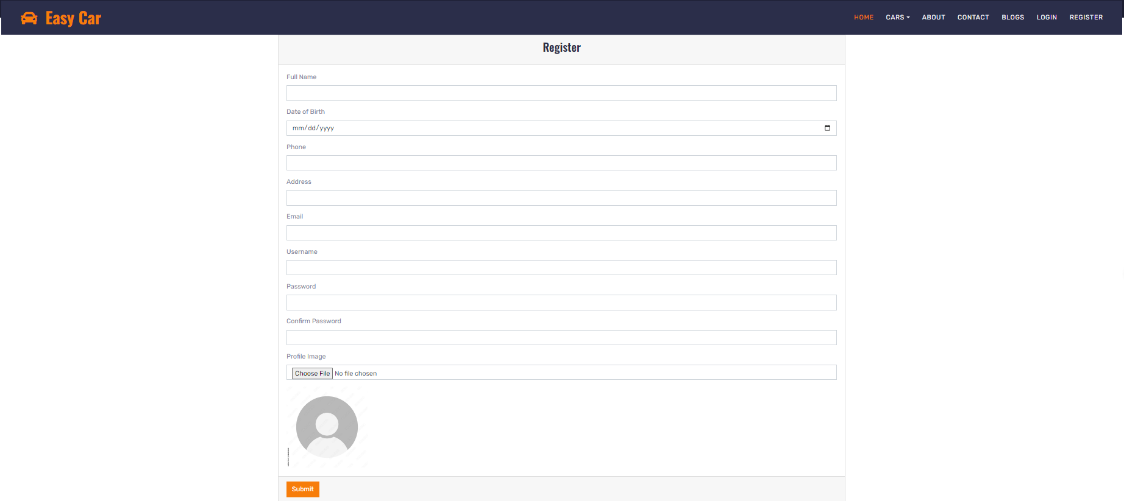
Giao diện Register

Slide 9
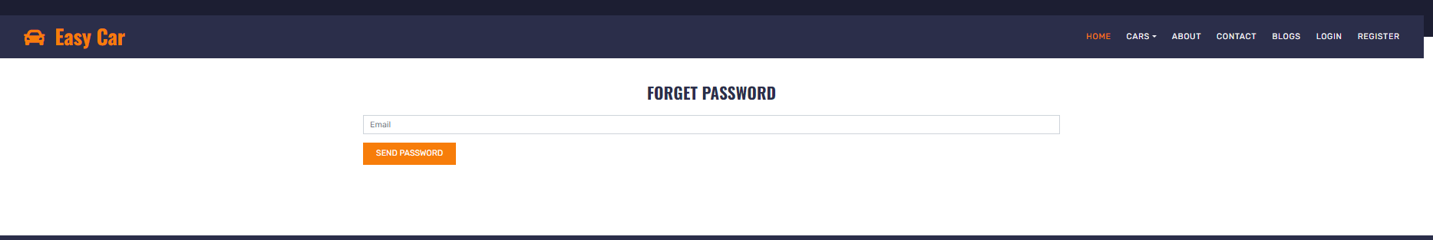
Giao diện Forget Password

Slide 10
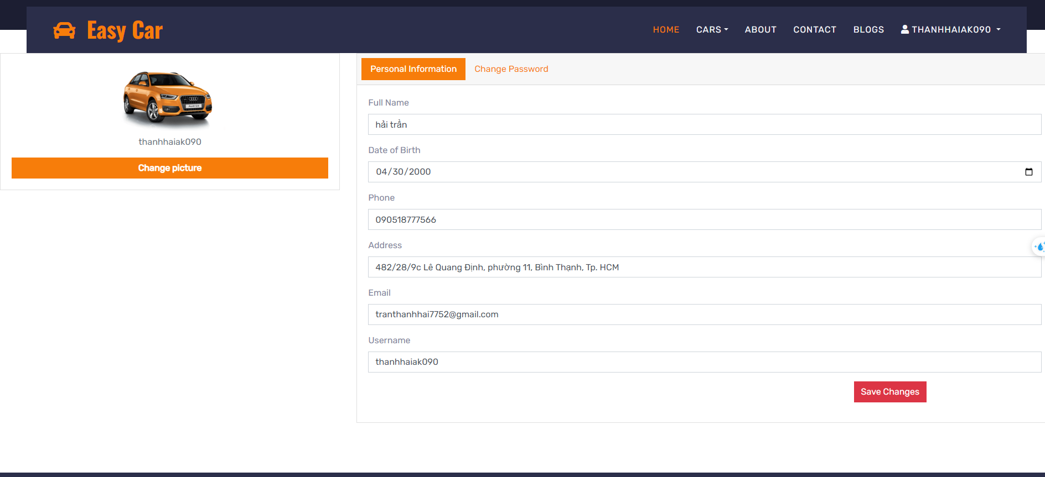
Giao diện Profile User

Slide 11
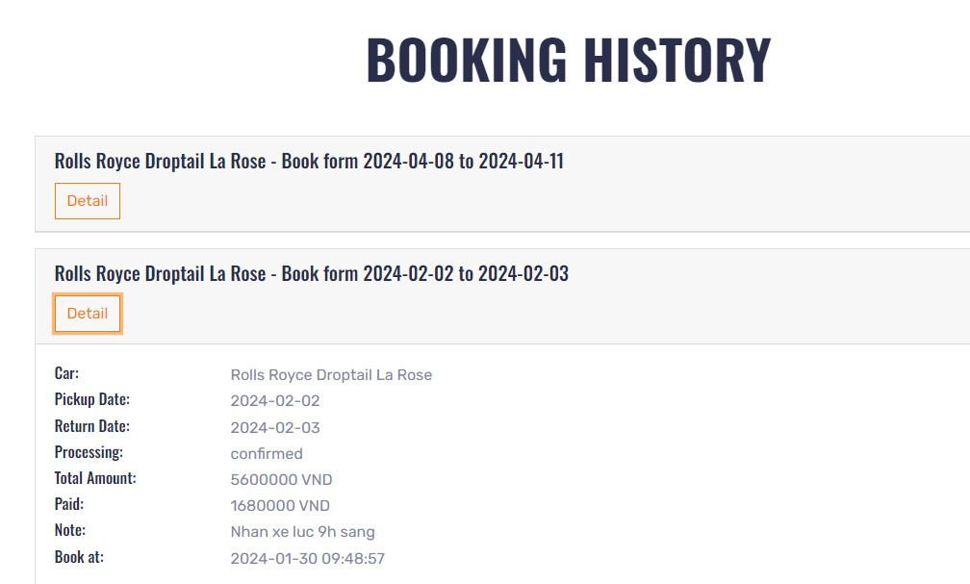
Giao diện History Booking

Slide 12
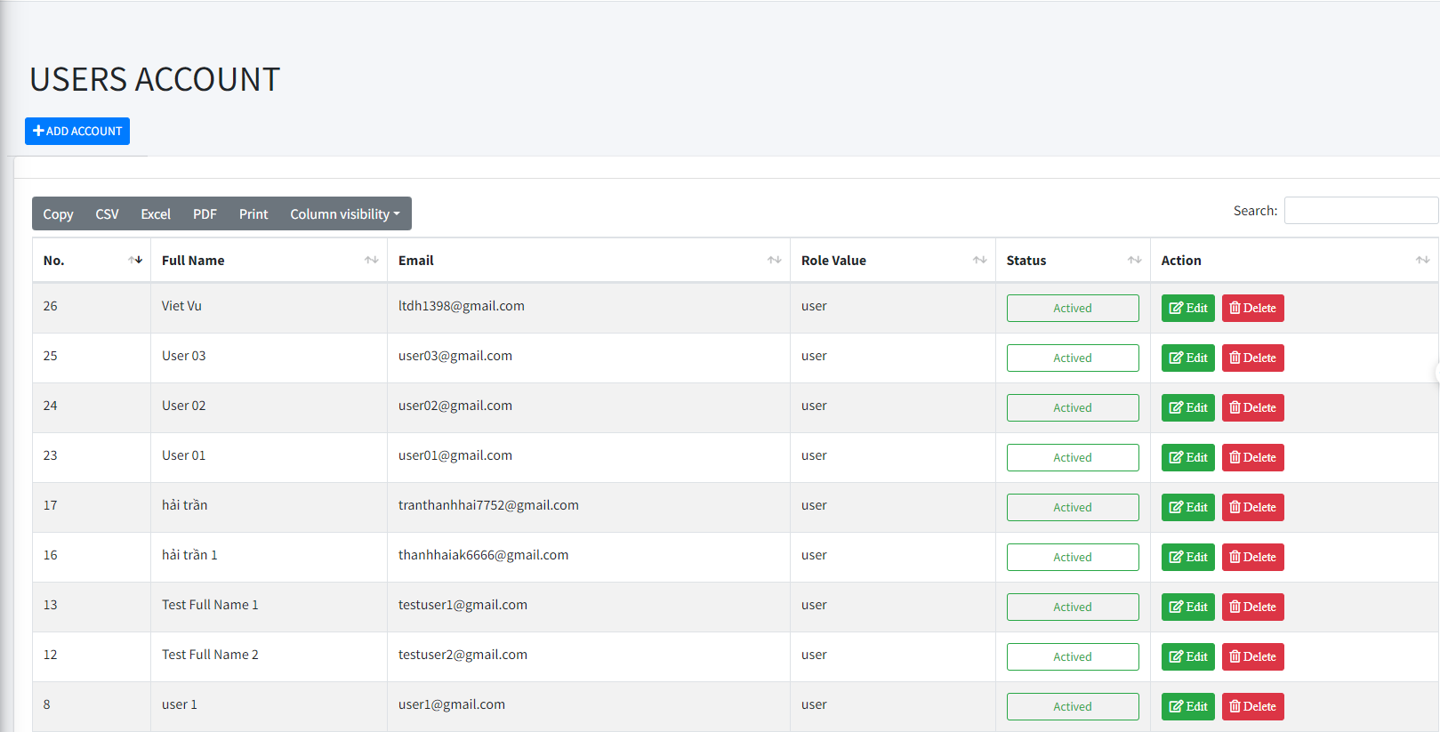
On this user management page we can add, edit and delete users
Manager User

Slide 13
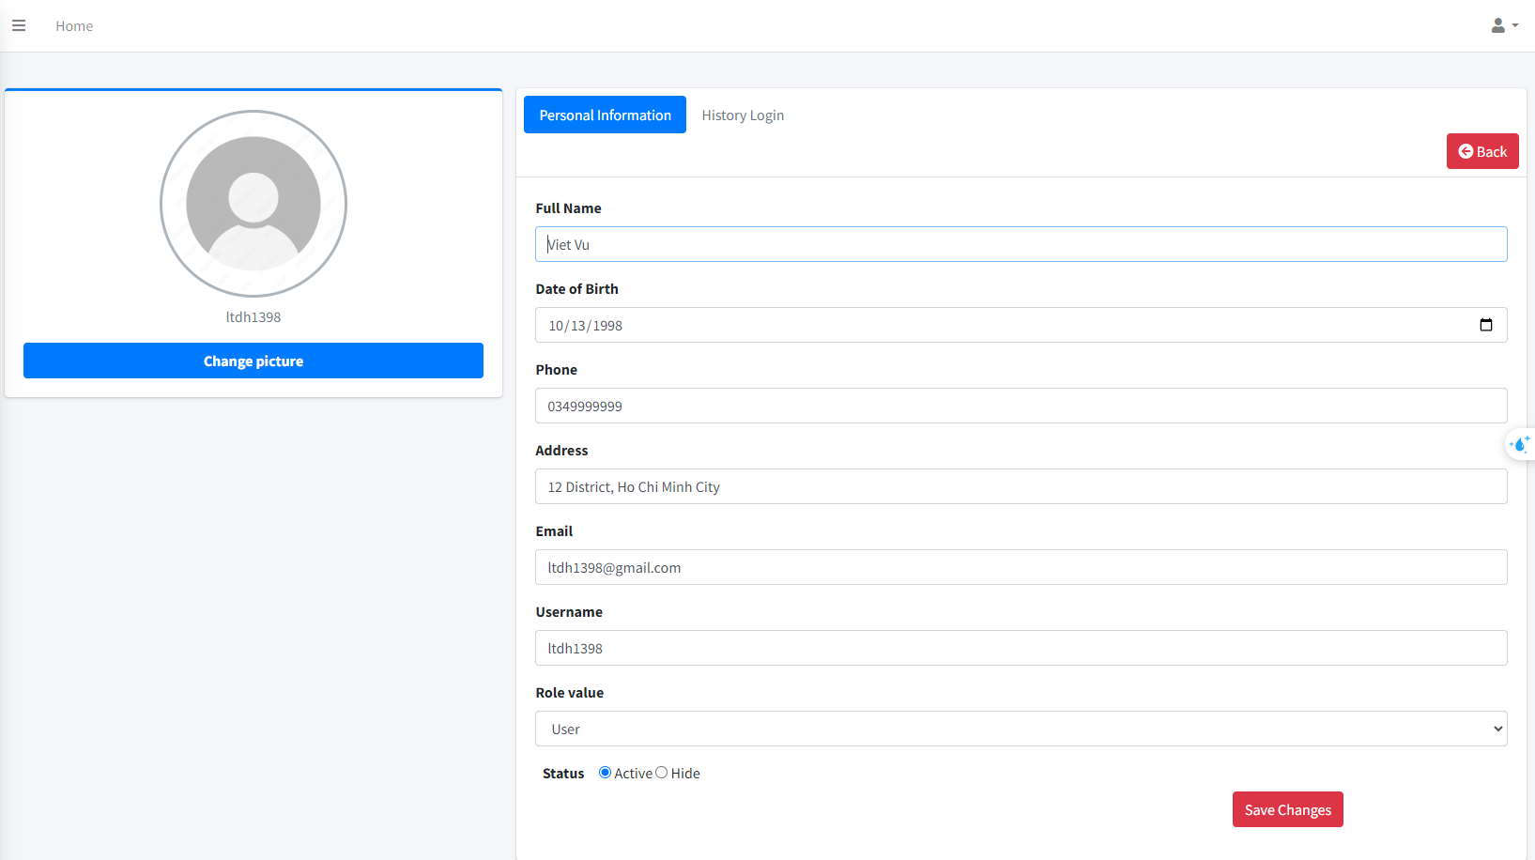
Here we have the right to modify the user's information when the user needs it, or ban it if it violates our policy.
Edit User

Slide 14
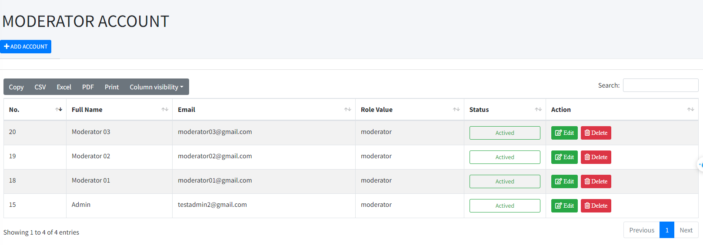
Manager Moderator

Slide 15
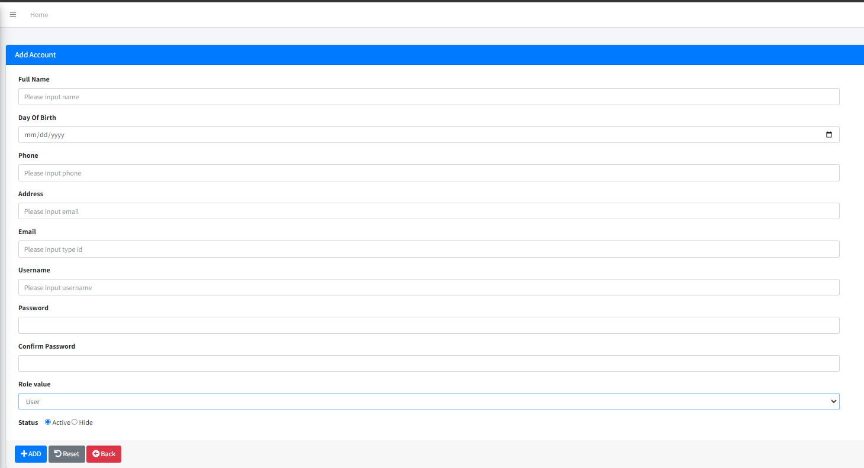
Add account button can add user or moderator
Button Add Account

Slide 16
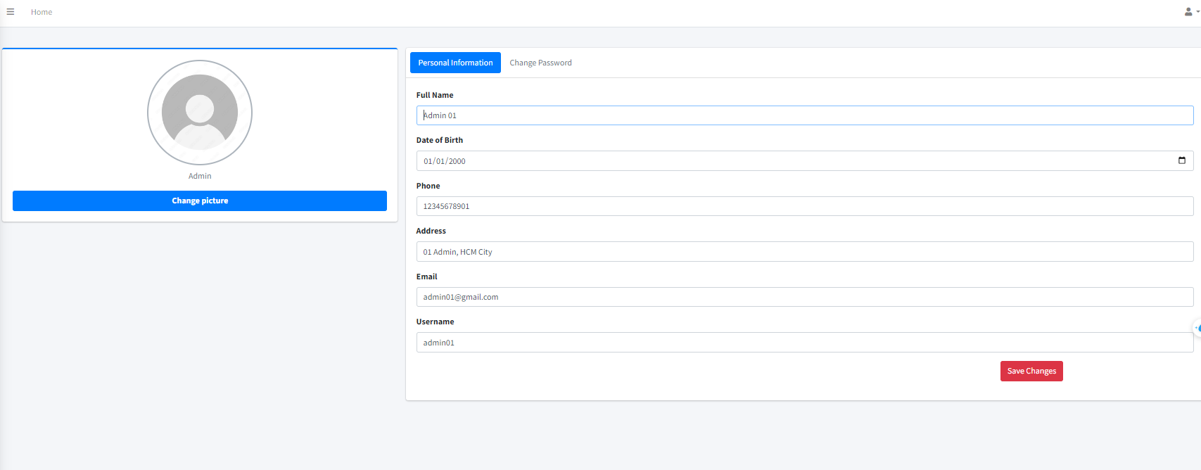
Admin interface

Slide 17
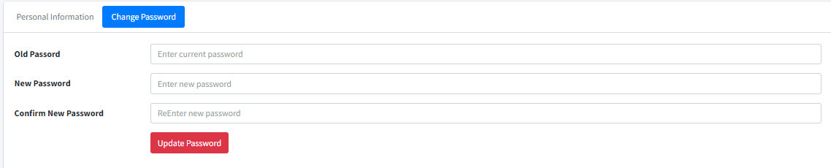
Change password

Slide 18
PHAN ĐẶNG HOÀNG TIẾN

Slide 19
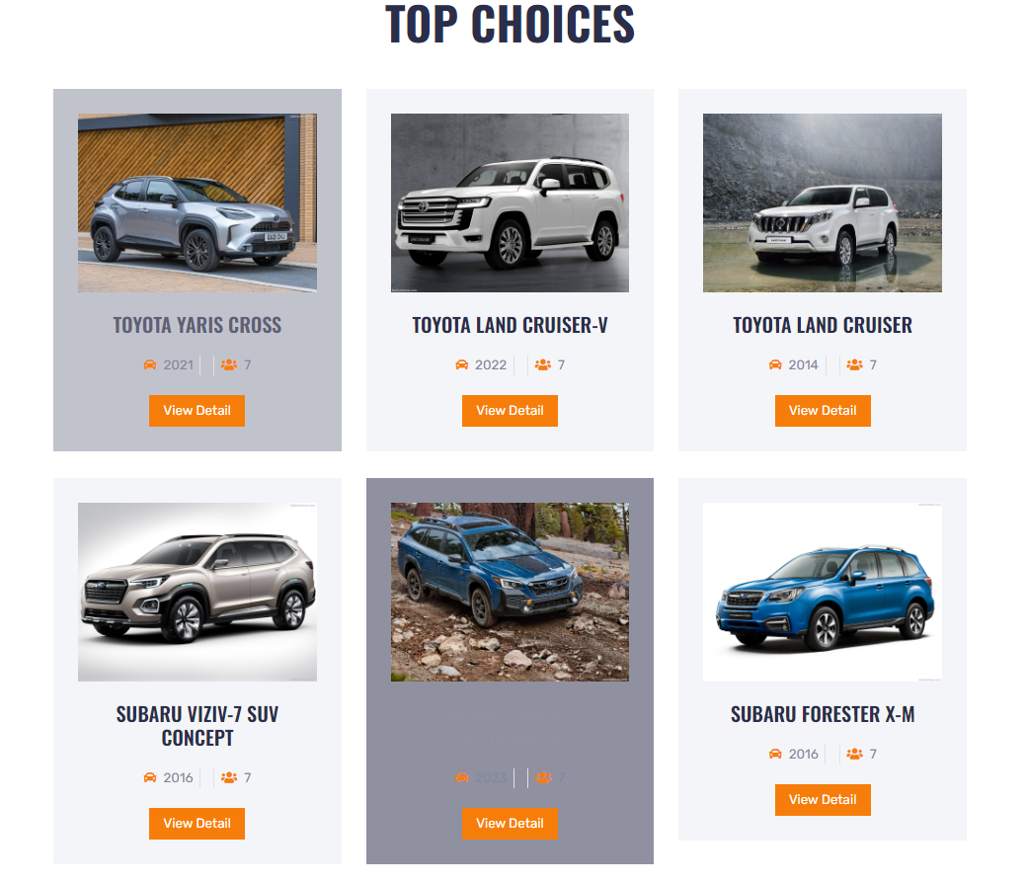
FRONT END INTERFACE

Slide 20
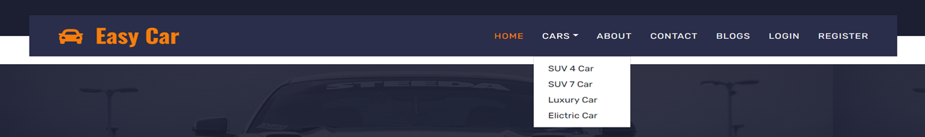
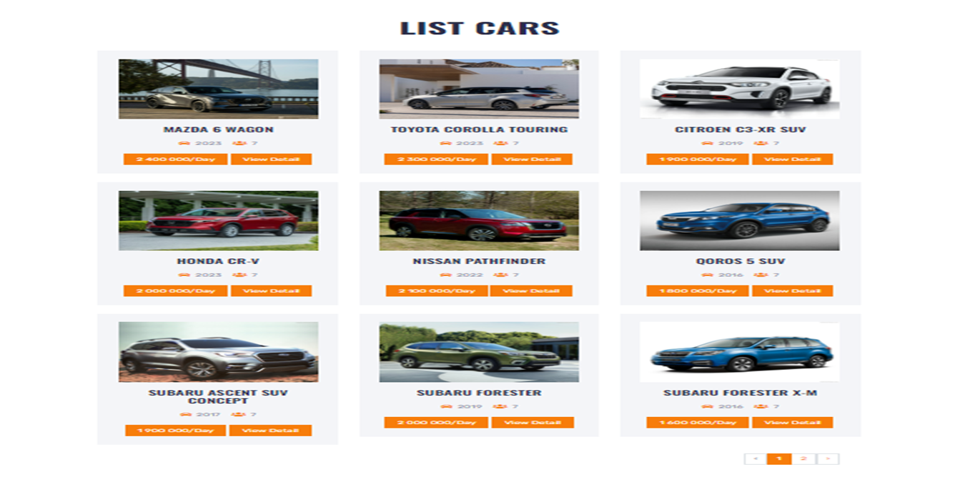
Category Interface

Slide 21
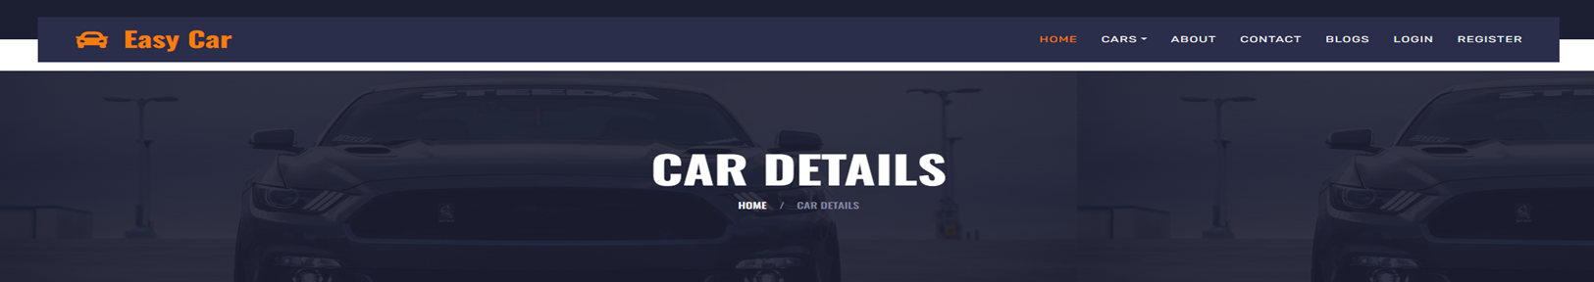
Detail car Interface

Slide 22
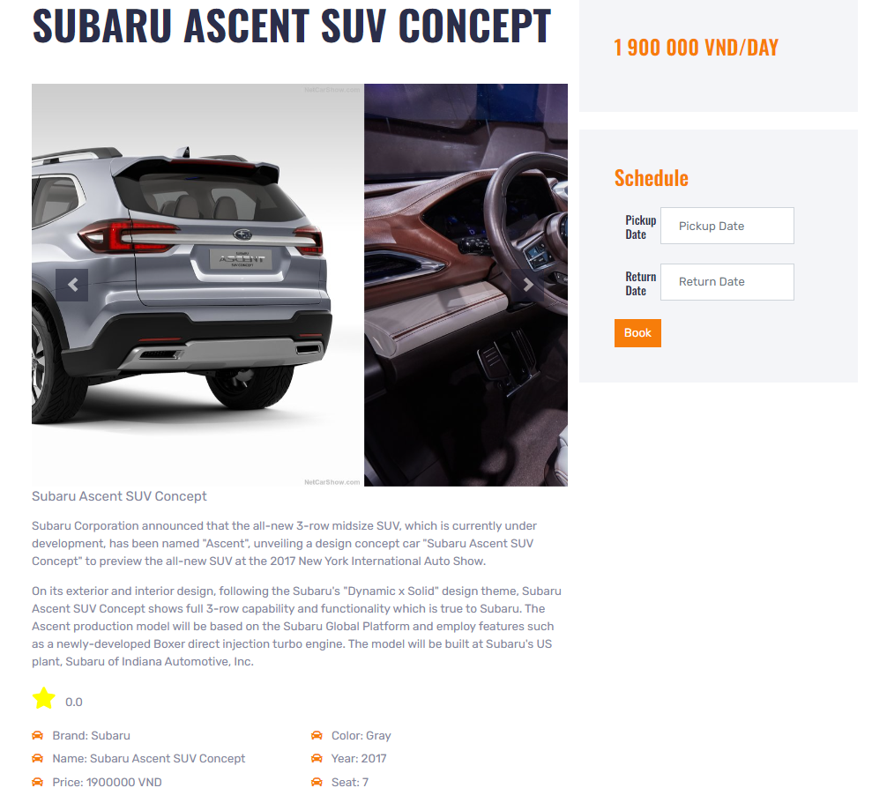
View DETAIL car

Slide 23
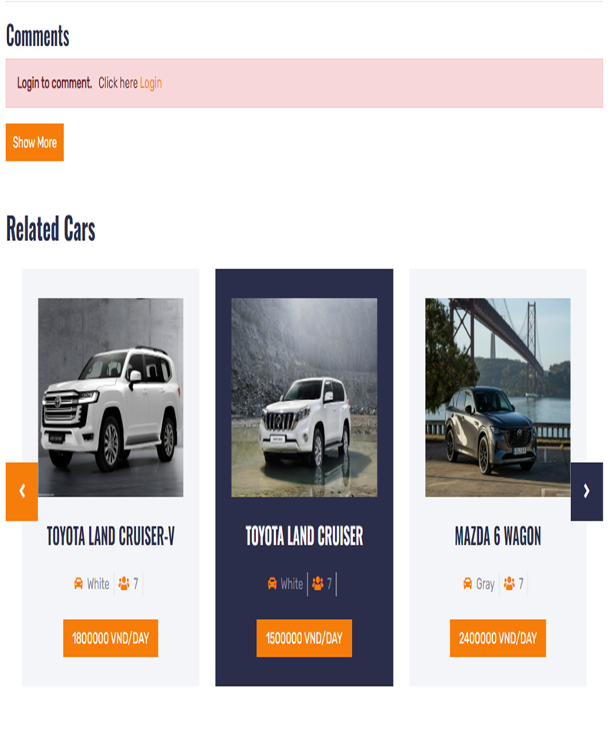
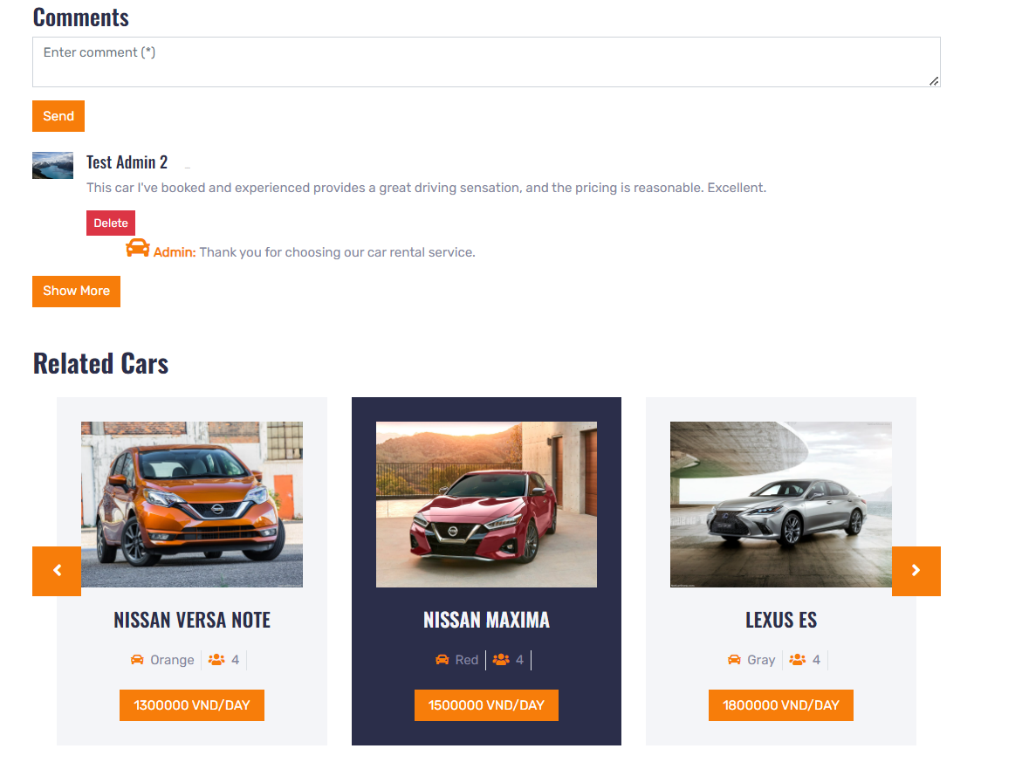
Interface for comments:
Not logged in and logged in.

Slide 24
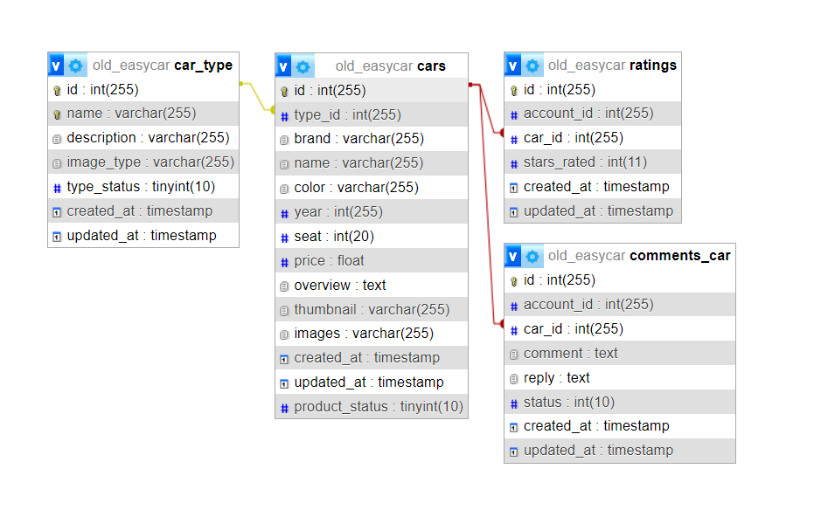
Diagram of Data Relationships between Tables

Slide 25
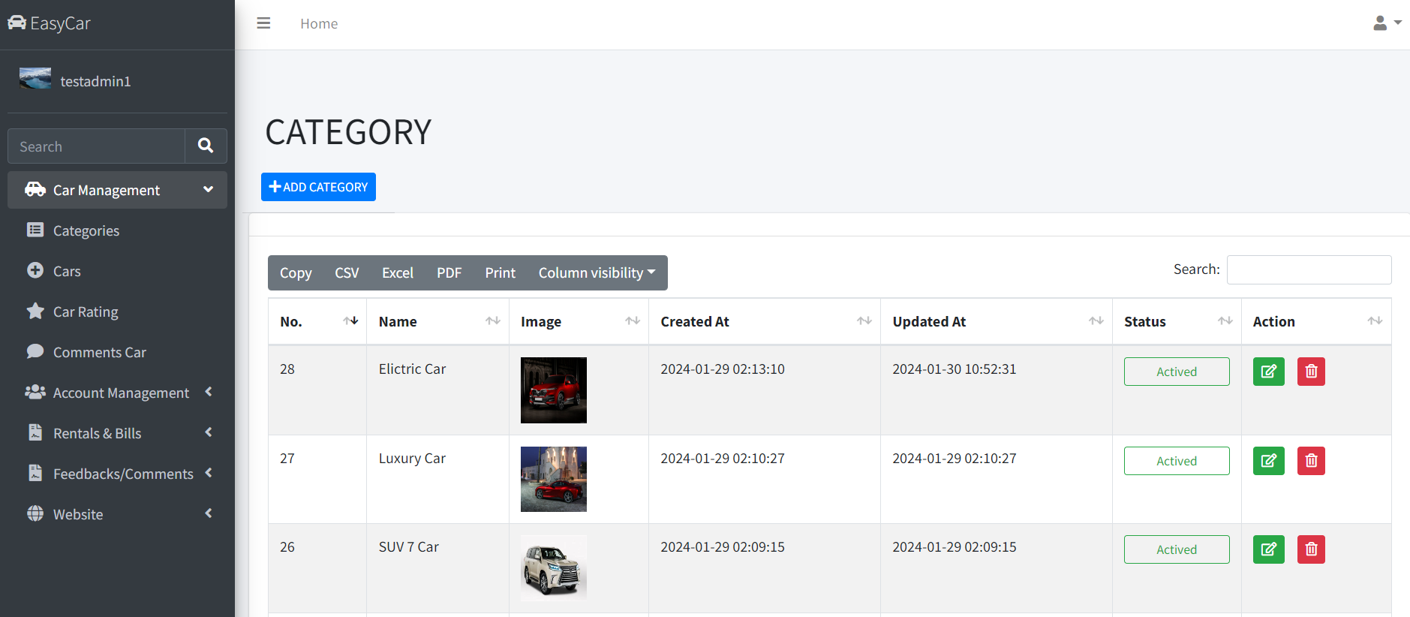
SYSTEM MANAGEMENT INTERFACE

Slide 26
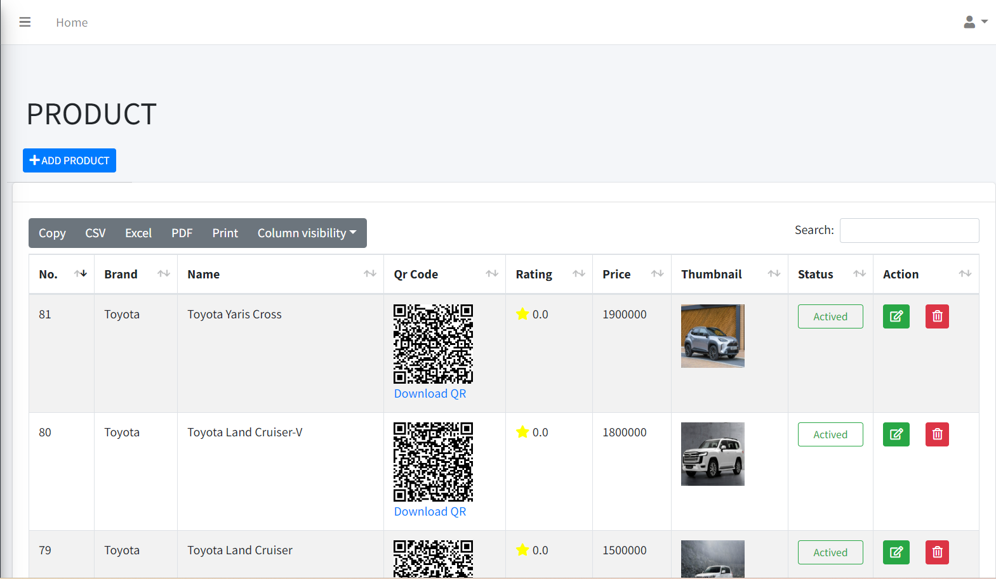
Car management interface

Slide 27
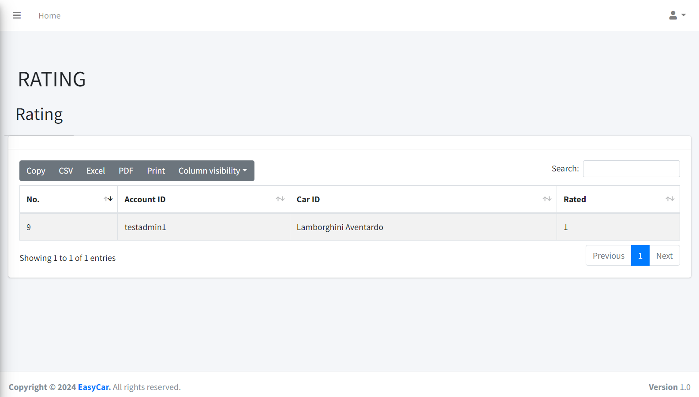
ratings

Slide 28
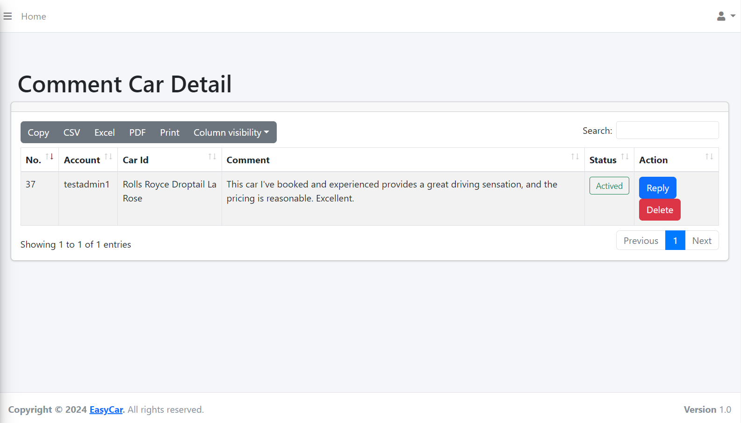
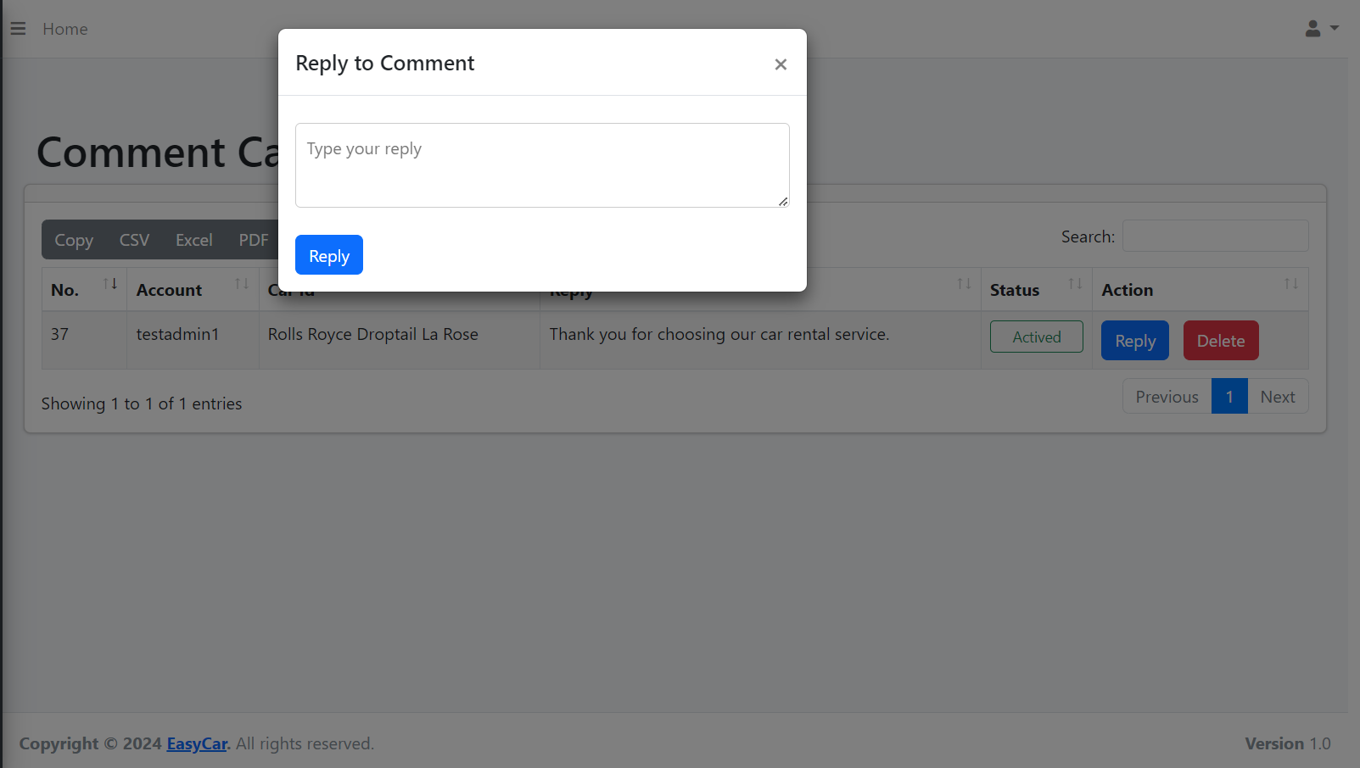
Car comments

Slide 29
VŨ QUỐC VIỆT
Visitor/user:
Search cars base on Schedule
Booking car base on Schedule
Payment with VNPAY
Admin/moderator:
Manage rental orders
Manage bills

Slide 30
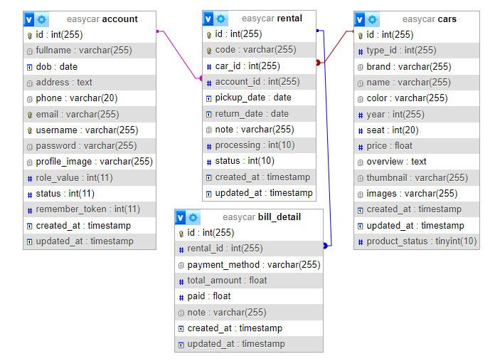
DATABASE

Slide 31
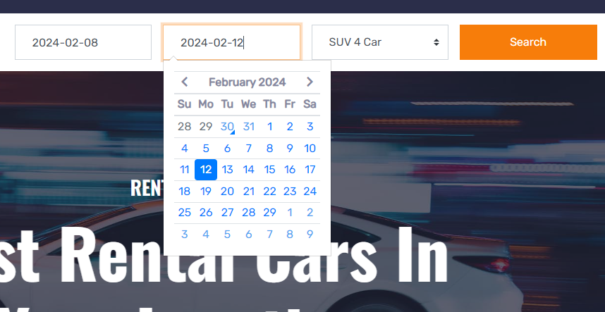
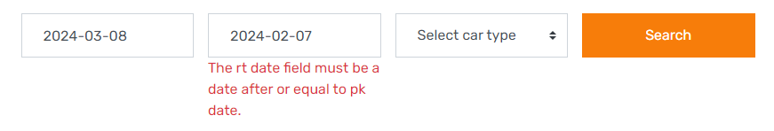
SEARCH CAR BASE ON SCHEDULE
Enter pick up and return date to search cars.
System will validate input data

Slide 32
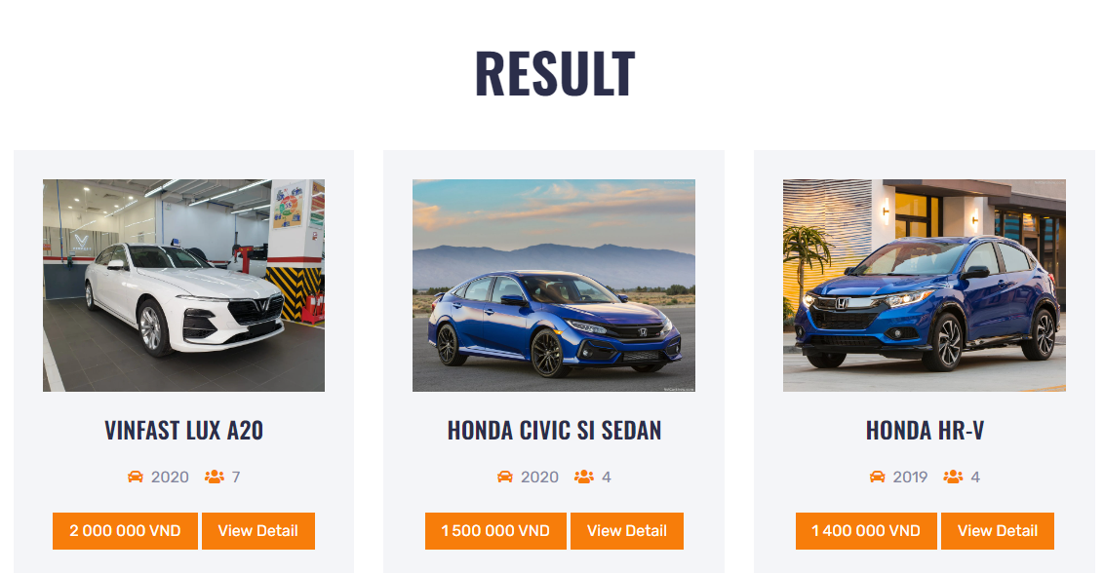
SEARCH CAR BASE ON SCHEDULE
List cars are available on input schedule

Slide 33
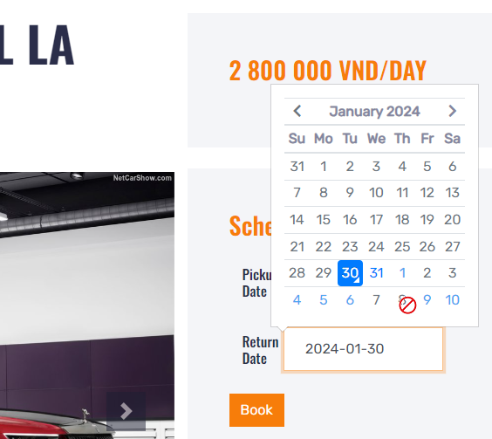
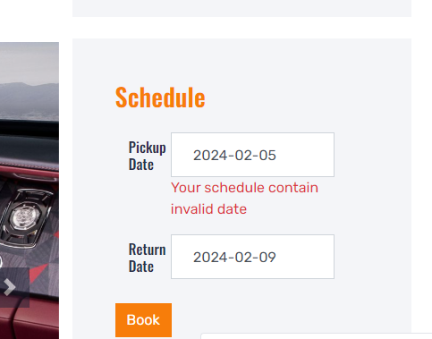
BOOK CAR BASE ON SCHEDULE
Website will disabled all previous dates, and dates when car is already rented and catch errors if users attempt to select invalid dates

Slide 34
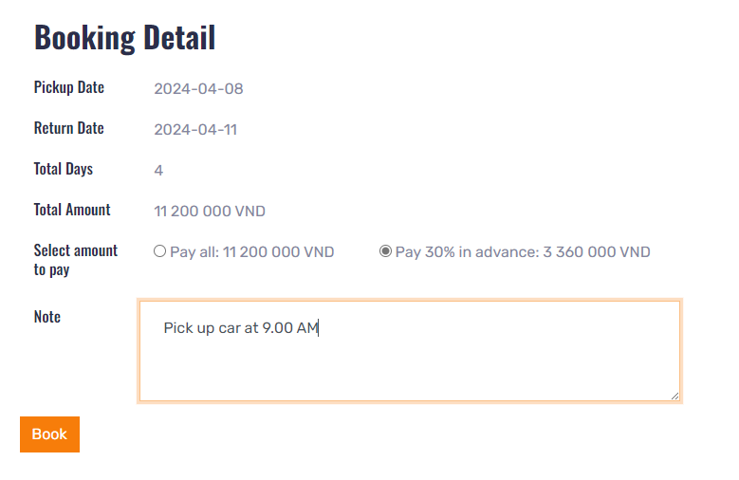
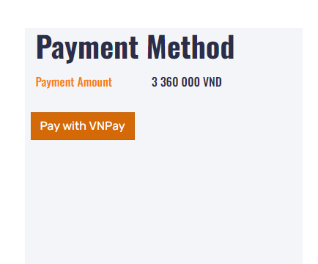
BOOK CAR WITH SCHEDULE
User can select the amount to pay in advance (100% or 30%), leave note.
Website use VNPay for payment

Slide 35
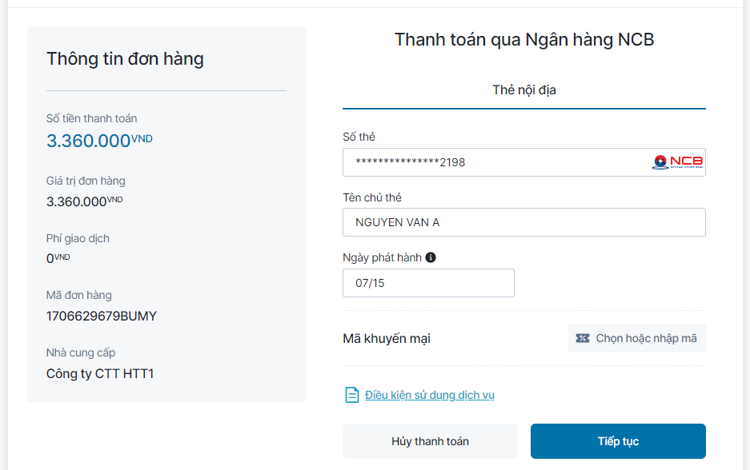
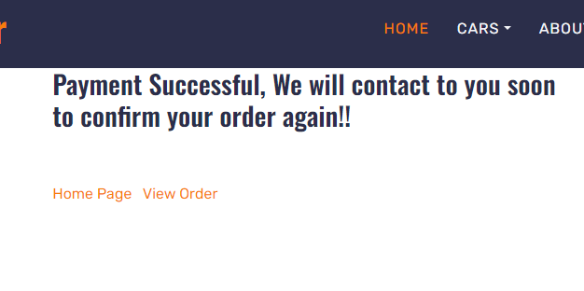
PAYMENT WITH VNPAY
After successful payment

Slide 36
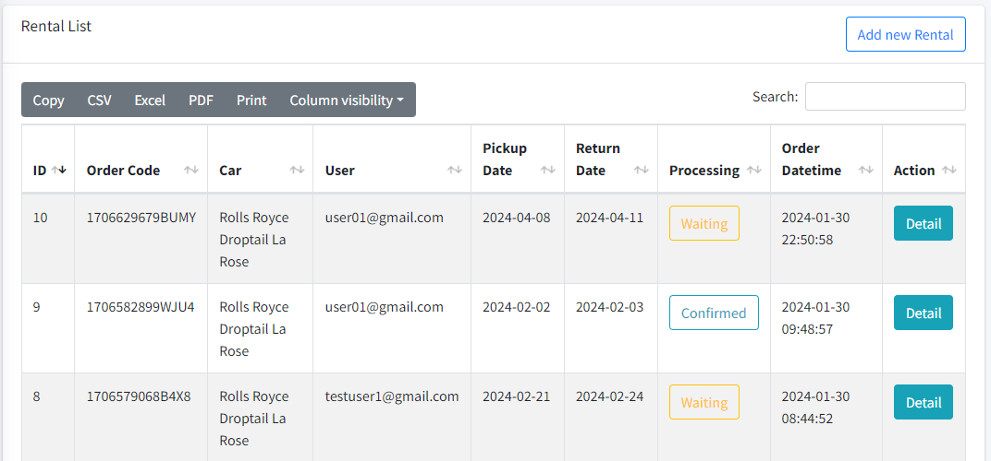
RENTAL MANAGEMENT
Add new rental and its bill by click button Add
Click Detail to view detail and edit

Slide 37
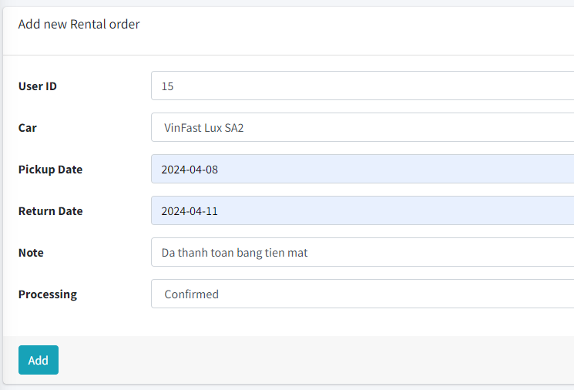
RENTAL MANAGEMENT
If user can’t make online payment, they can pay in cash, and admin will add rental order for that user.

Slide 38
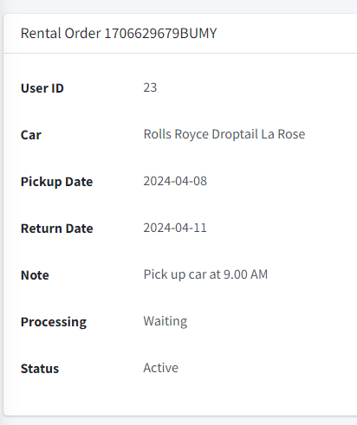
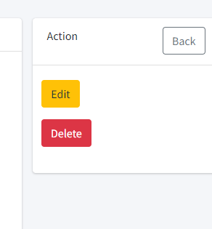
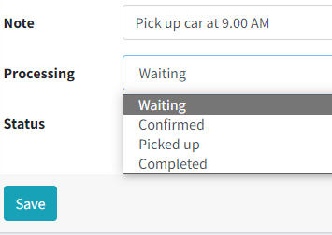
RENTAL MANAGEMENT
Click Edit button to Edit rental order ( Change processing, status,…)
Click Delete button to delete this rental order and its bill detail.

Slide 39
NGUYỄN QUỐC THIỆN

Slide 40
Giao diện Feedback

Slide 41
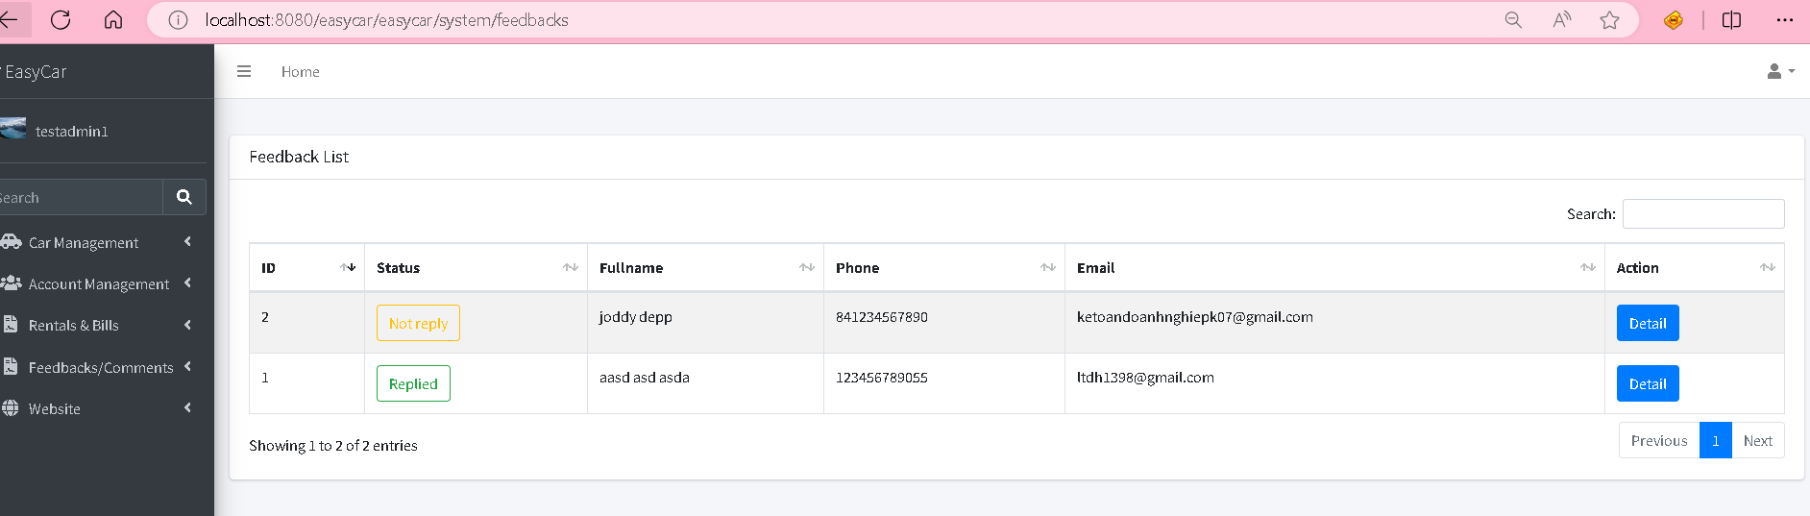
Quản lý Feedback

Slide 42
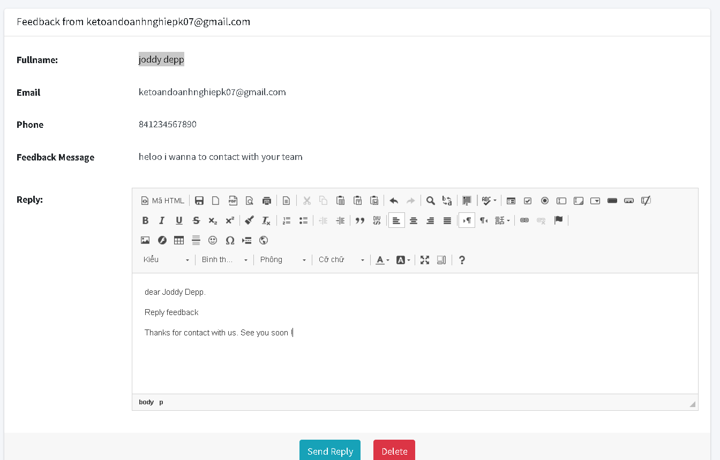
Reply Feedback

Slide 43
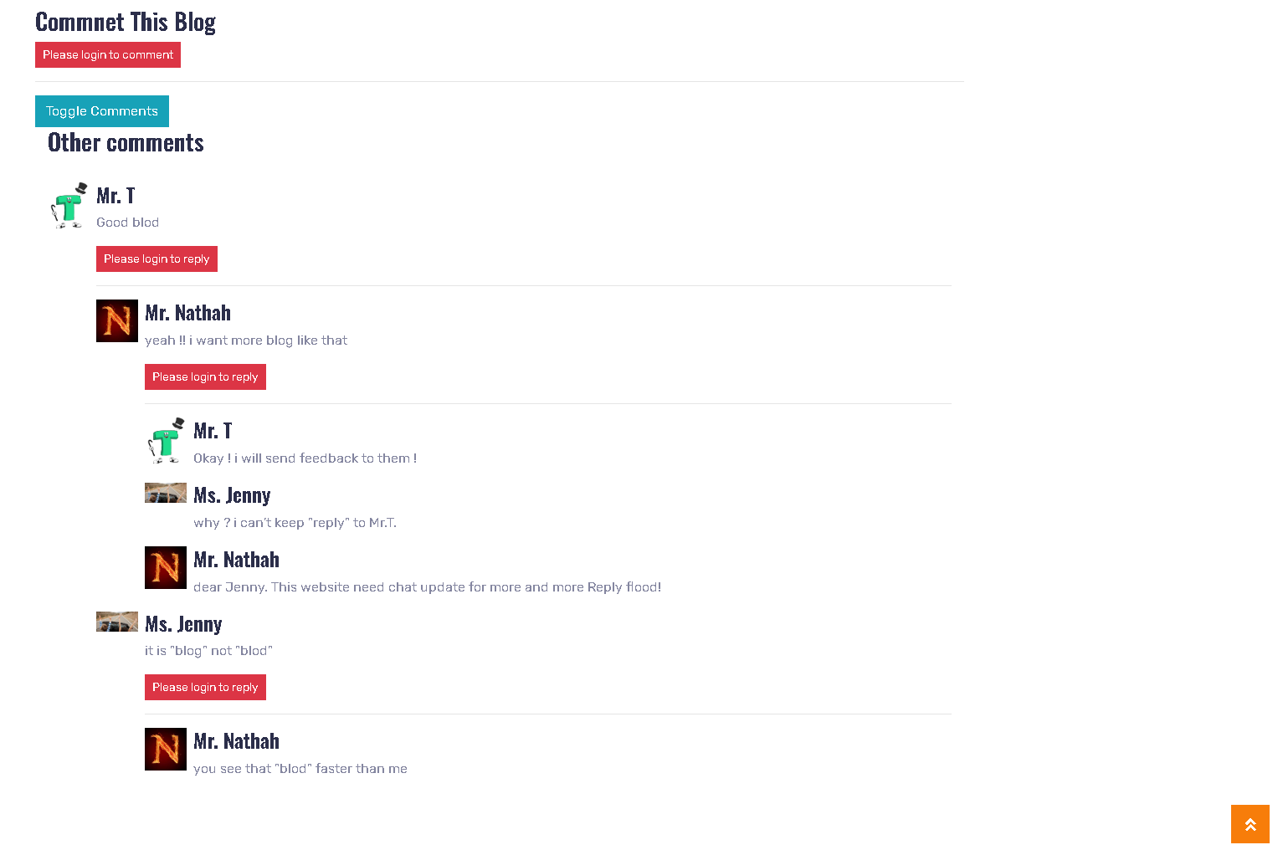
Giao diện comment blogs

Slide 44
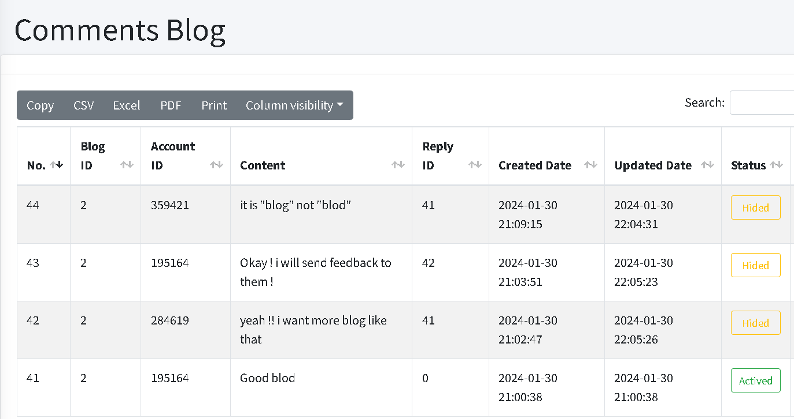
Quản lý comment blogs

Slide 45
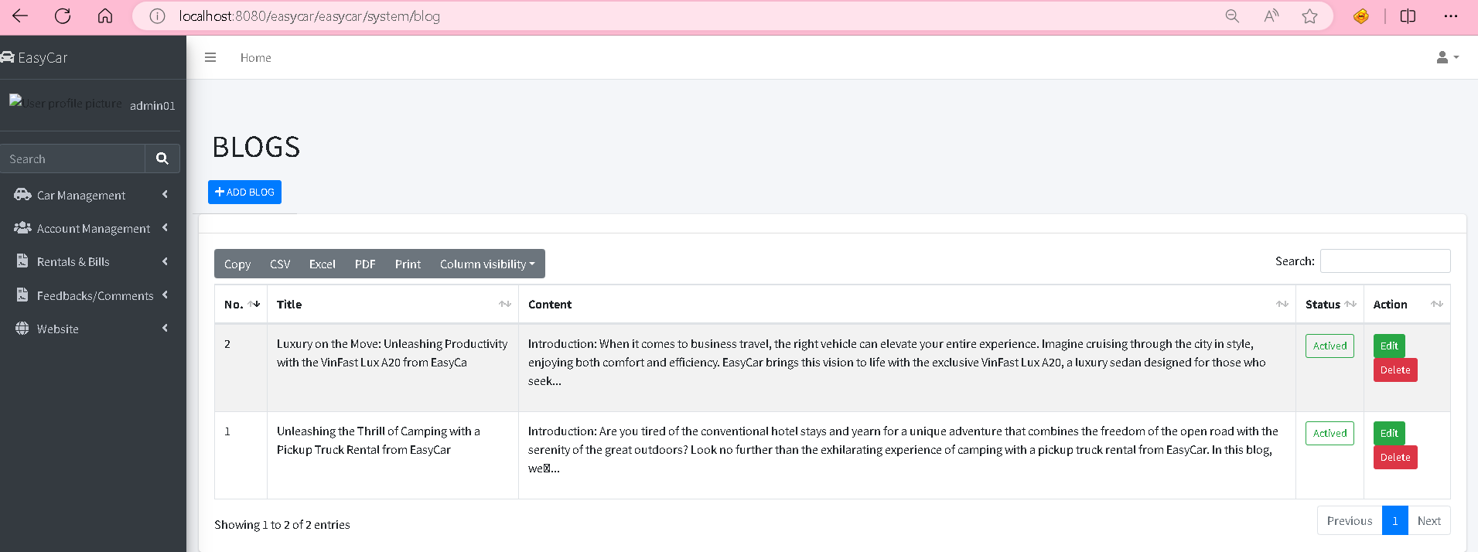
Quản lý blogs

Slide 46
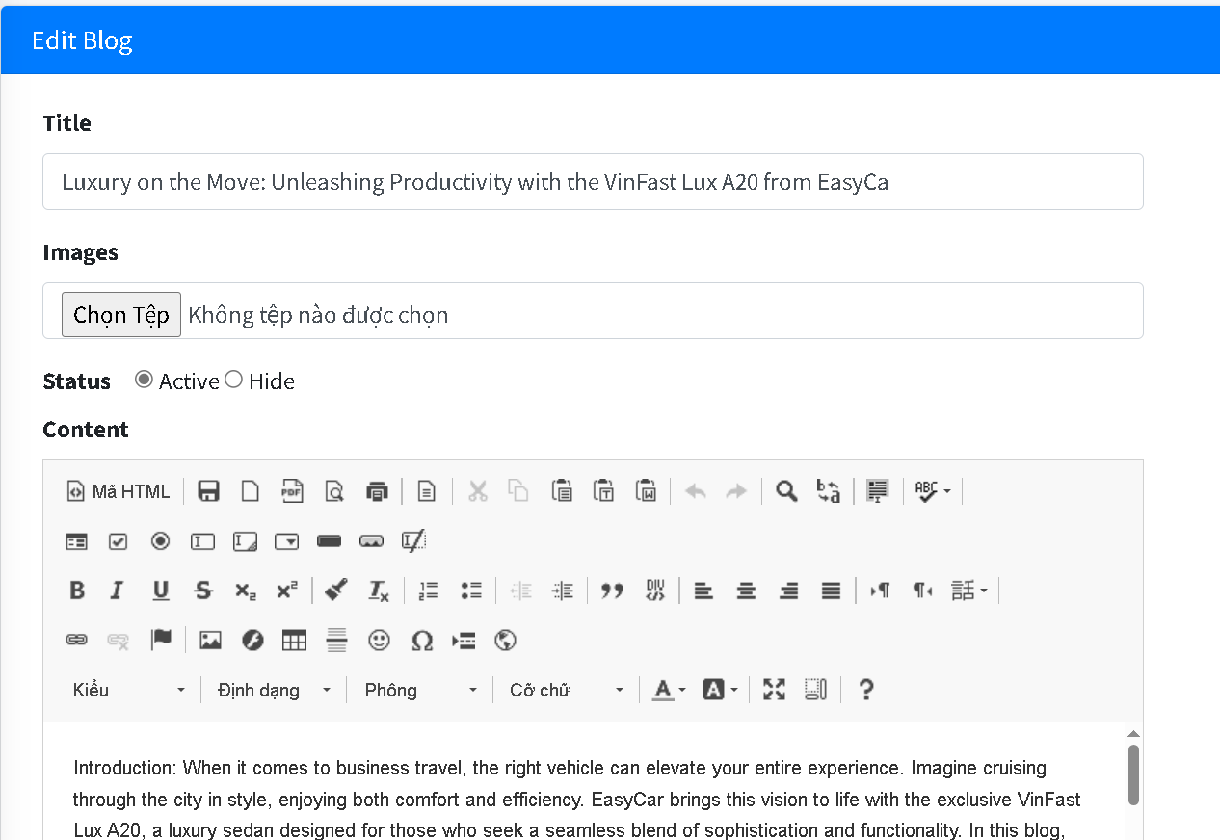
Edit blogs

Slide 47
Thank you for listening!!

